Slide 1

Module 8:
Refuting
Polytheism

Slide 2
How do we refute Polytheism?
The same way we do the others
The same 4 principles
we use for reasoning with unbelievers...

Slide 3

Problems to lookout for
1.) Opinions
and Self-Contradictions
2.) Unargued, privileged beliefs
3.) Sibling Rivalry
4.) Stealing from God

Slide 4




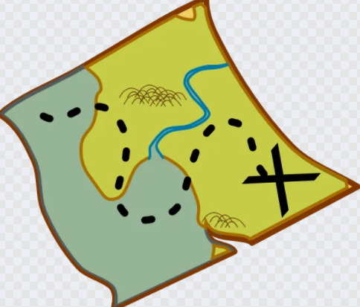
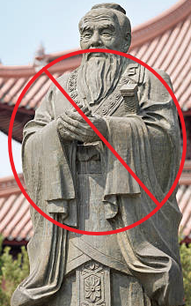
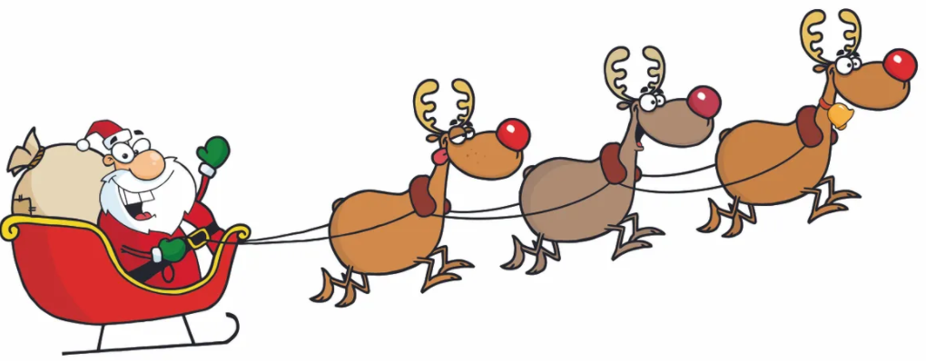
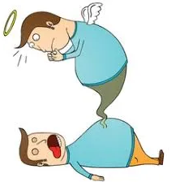

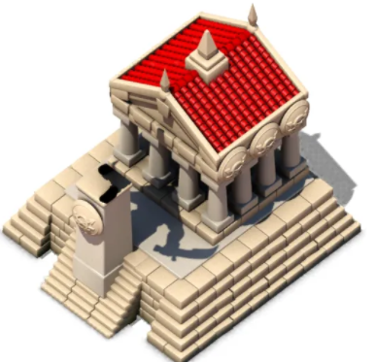
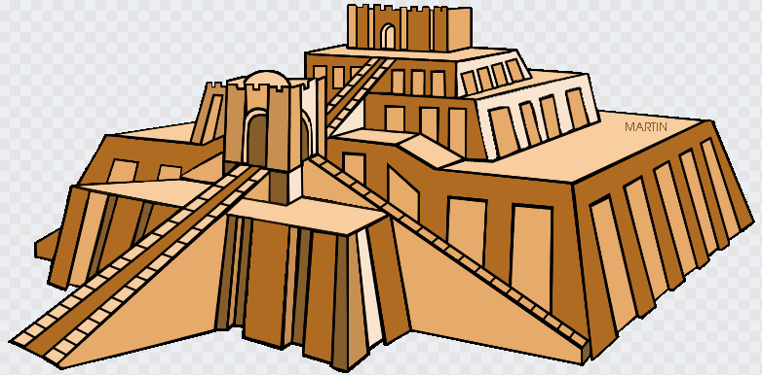




Review – 4 Worldviews
Materialist
A spiritual oneness
Dualist
Polytheism
Monotheism
Notes:
Why won't these work?
1.)Atomism: time + chance, acting on matter.
Atoms can't be universal, constantly change.
Logic is universal and unchanging.
Atoms insufficient as source of moralsm, choice, and logic.
We all hold others to moral standards. No one lives as if atheism is true.
2.)Confucious say? That's his opinion.
The Christian God knows everything. He doesn't
3.)Multiple gods means competing sources of authority, destroying the possibility of unchanging universals such as logic or truth in morality.
Also, how was it revealed?
Able to create life and the universe?
4.)The other Abrahamic religions depend on Christianity and contradict on their own standards.
-Others: can their deity support universals? Creation? Human nature, value

Slide 5
Why is polytheism
not able to be the source of logic or universal moral values?

Slide 6
Multiple gods – multiple standards
Polytheism would give multiple standards of logic,
making it not universal
and unchanging.
Would also make
truth in moral oughts
impossible as well
Multiple gods would mean multiple competing laws of logic as well.

Slide 7
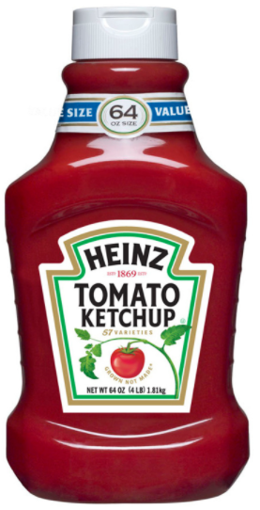

Henotheism
gods can take turns
to be the 'top' god
They are interchangeable

Slide 8
How to refute polytheism?
The same way you do the others
with the "reasoning with unbelievers"
content
You demonstrate how
the unbeliever must borrow
from the Christian worldview
to behave in a way inconsistent
with his own worldview

Slide 9

Polytheism is unable to
make human experience
or truth possible
Demonstrated the absurdity of
belief in it

Slide 10

Next Module:
How to refute non-Christian
monotheistic worldviews

Slide 11

End of Module 8
Questions?

